Slide 1
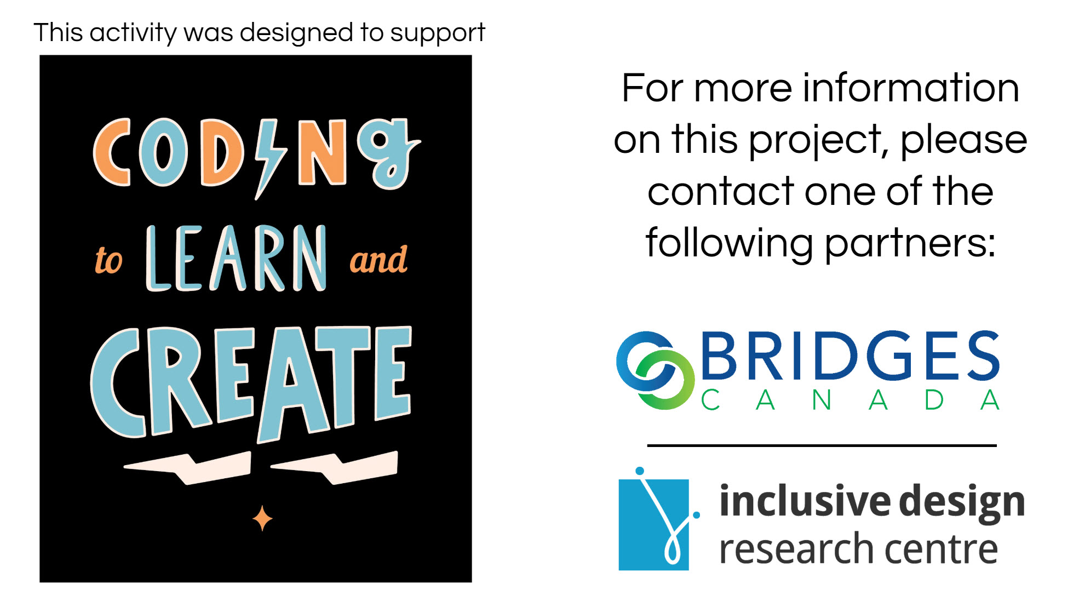

This activity was designed to support Lesson 9 of
© Bridges Canada Inc.
Reproduction prohibited.

Slide 2

Part 1
Introduce

Slide 3


The “Wait for” blocks

Slide 4
Part 1
Anchor

Slide 5

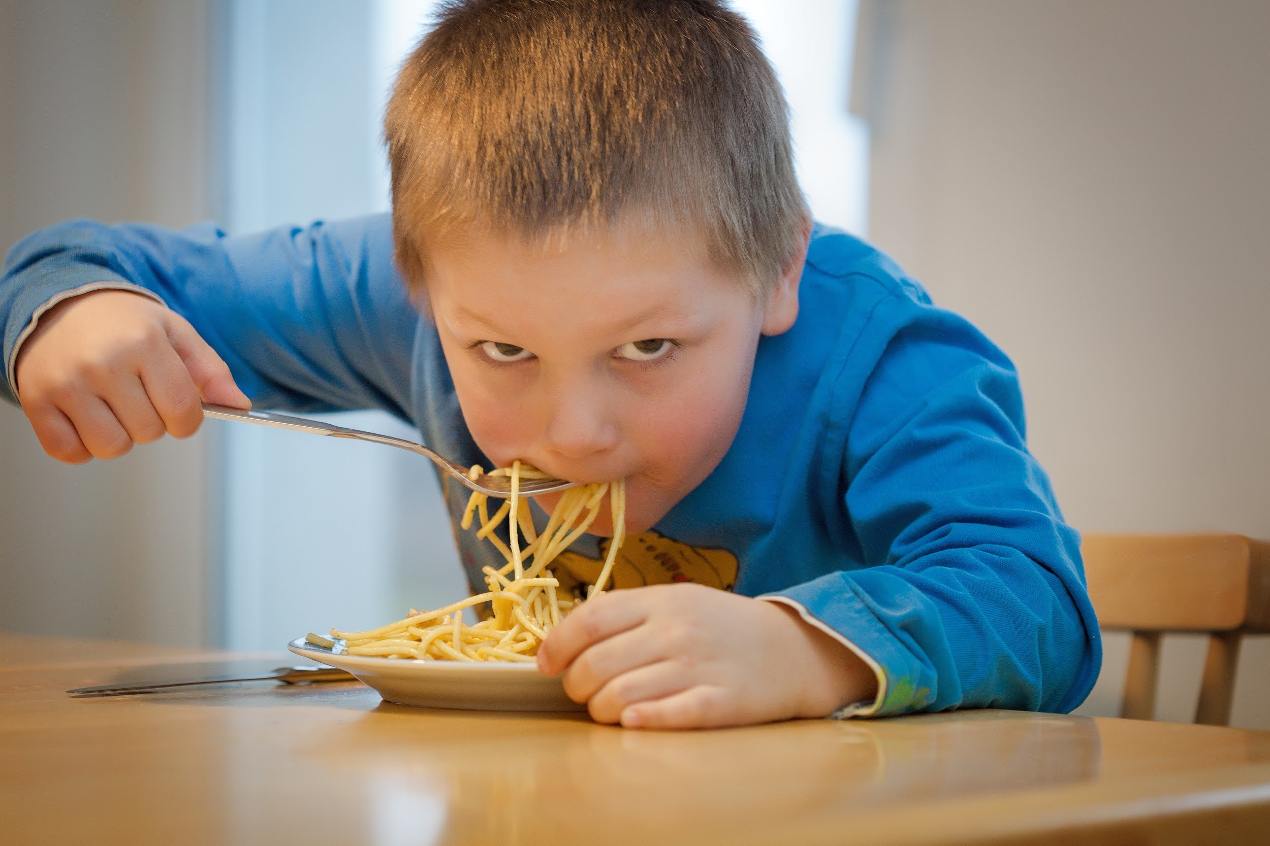
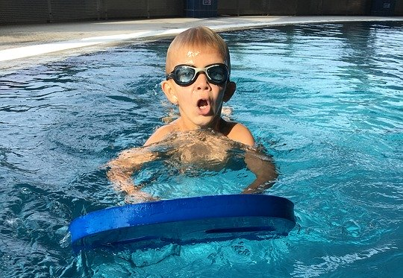

Wait for “x” seconds...

Slide 6


Wait for “x” seconds...

Slide 7
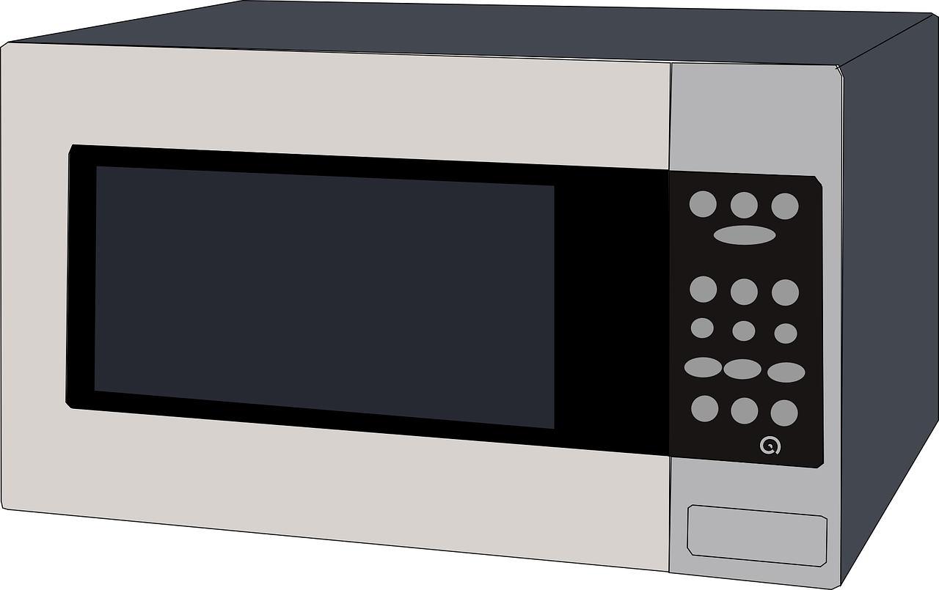
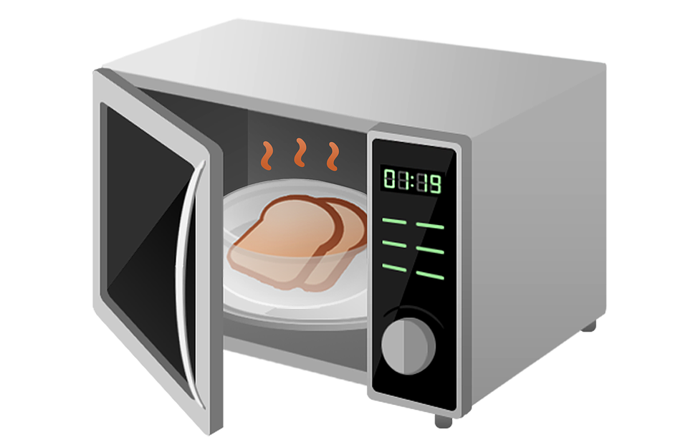
Wait for “x” seconds...

Slide 8
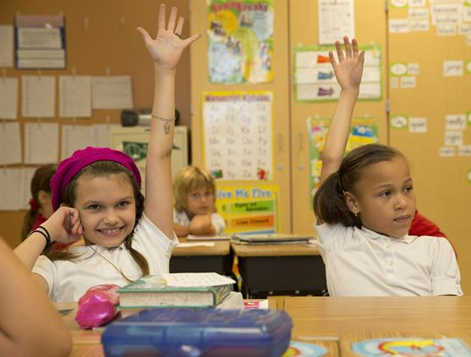
Wait for...
Answering a question in class
Students sit and listen to question
Students raise their hand with an answer and WAIT FOR...

Slide 9
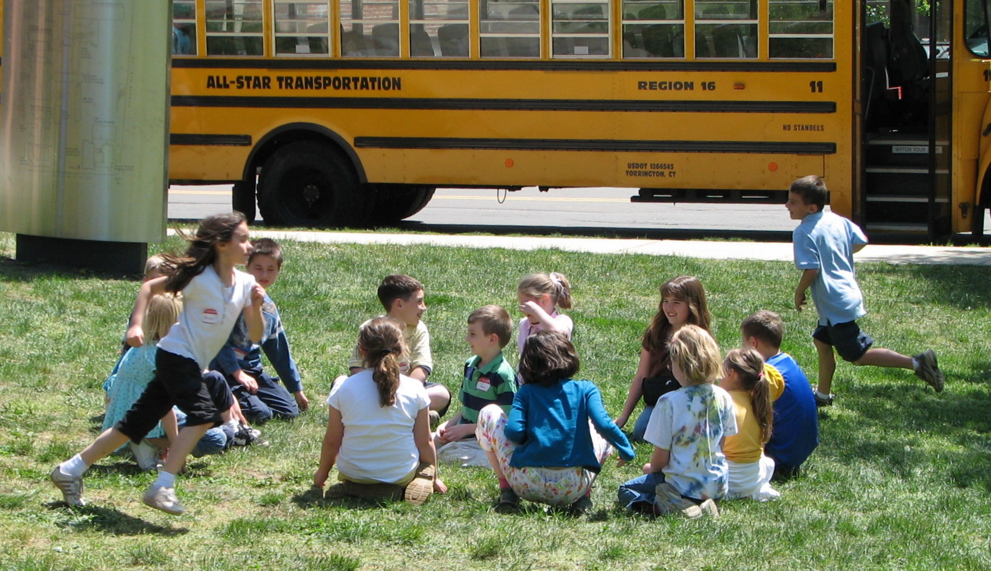
Wait for...
Playing Duck, Duck, Goose
One player walks around the circle, touching each head saying “Duck”
Other players sit and WAIT FOR...

Slide 10
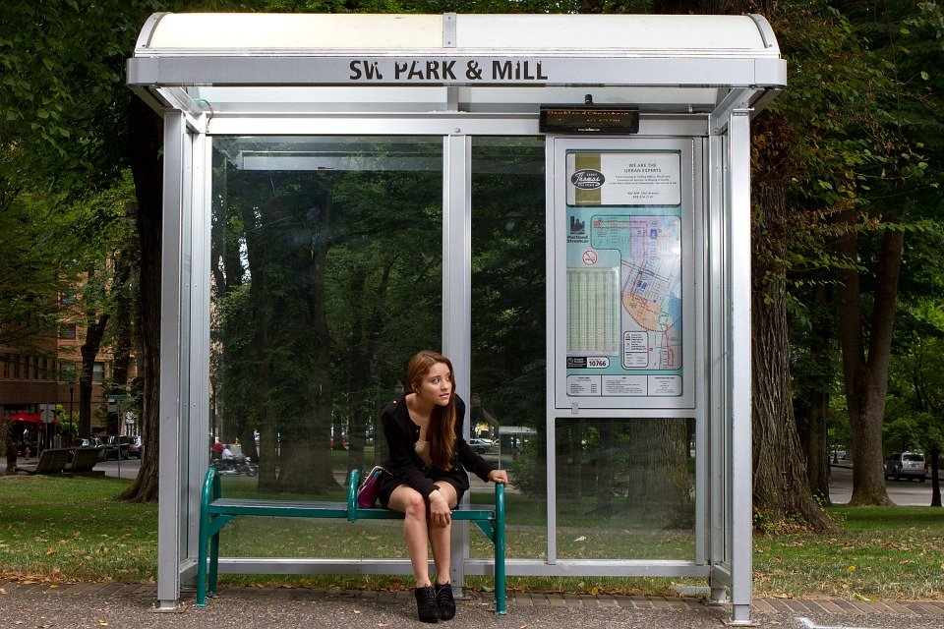
Wait for...
Taking the bus
Walk to the bus stop
Sit and WAIT FOR...

Slide 11
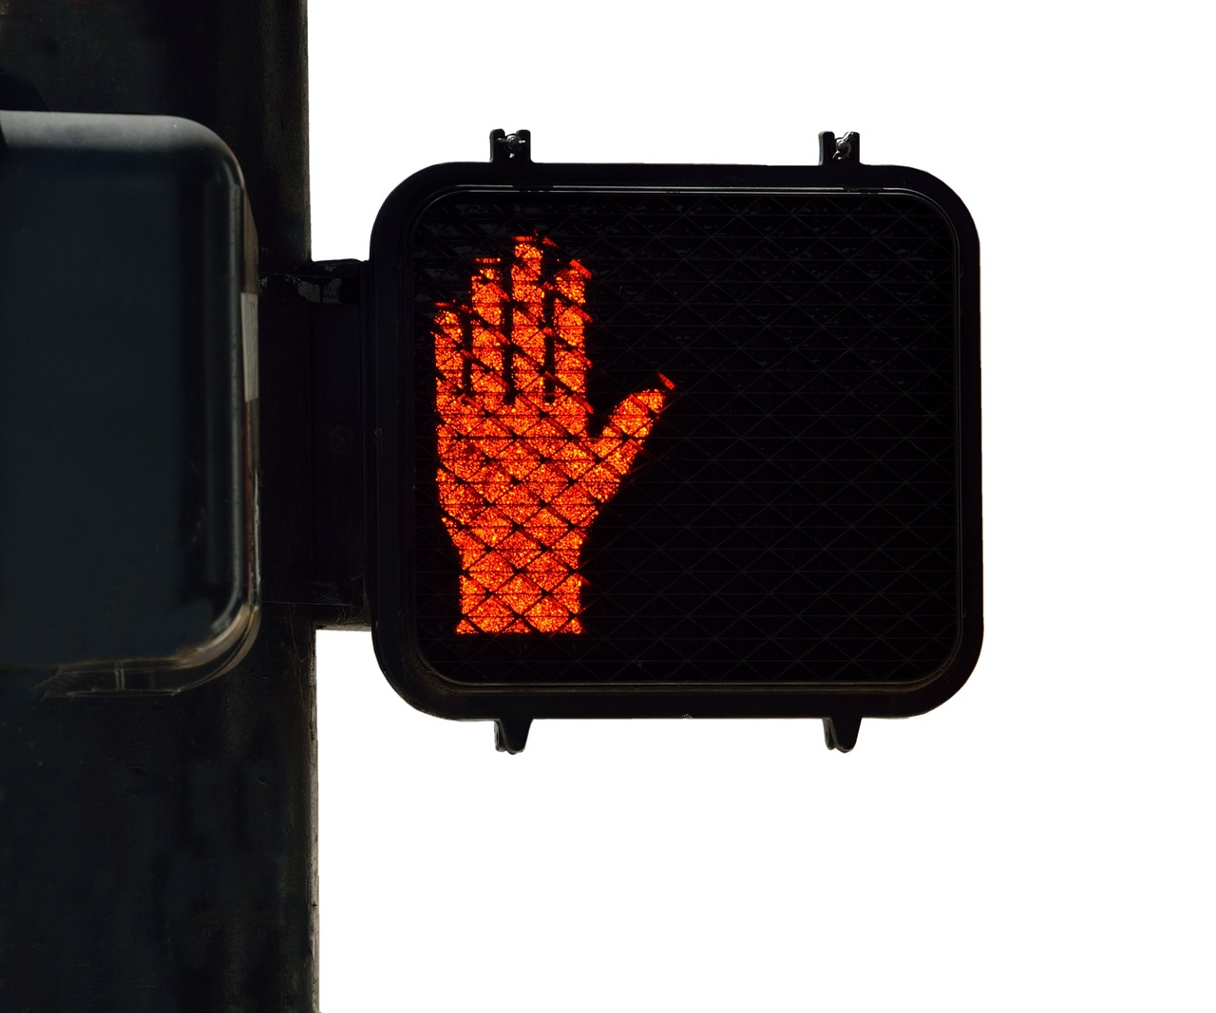
Wait for...
Walking down the street
Walk to the corner of the street
Stop and stand at the corner and WAIT FOR...

Slide 12
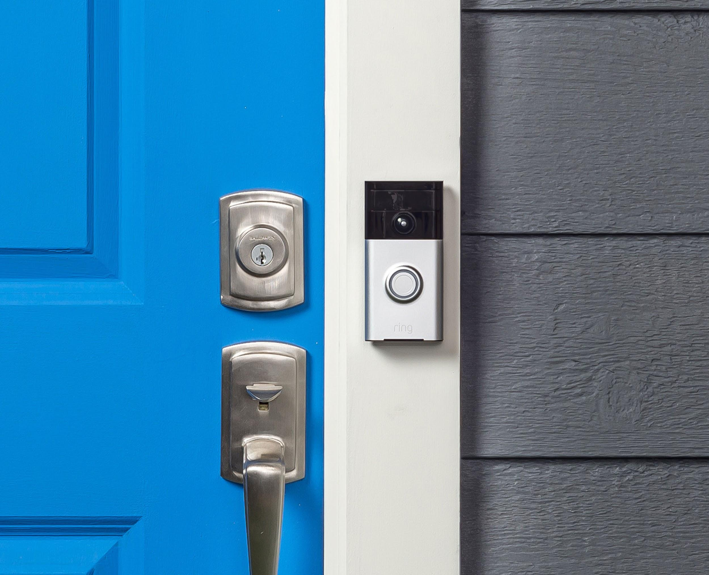
Wait for...
Visiting someone’s home
Walk up to the door
Ring the doorbell and WAIT FOR...

Slide 13
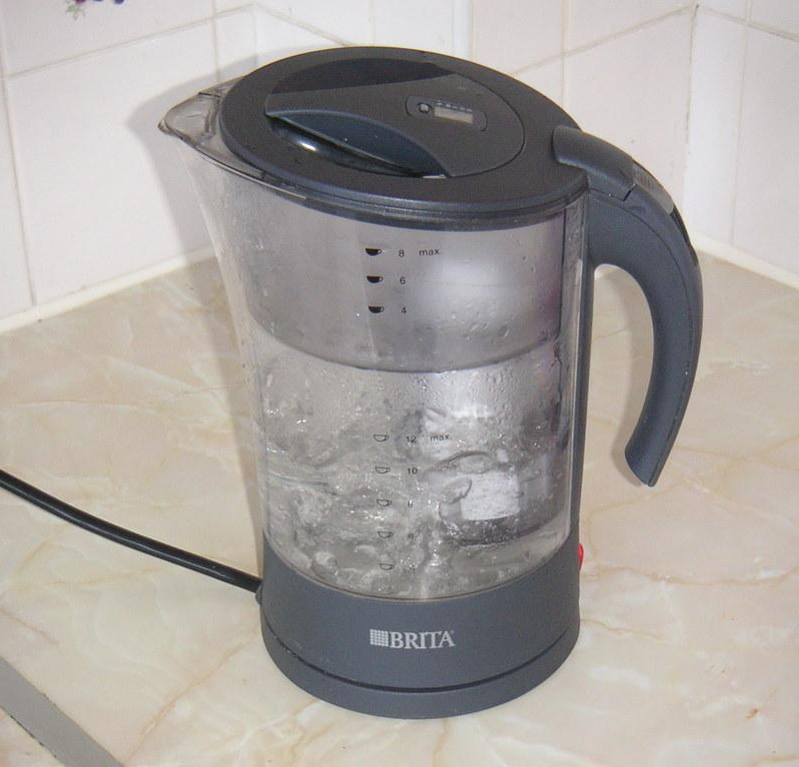
Wait for...
Making hot chocolate
Put scoops of hot chocolate in mug
Plug in the kettle and WAIT FOR...

Slide 14
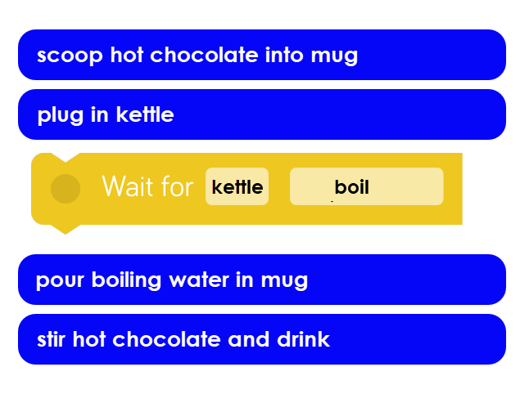
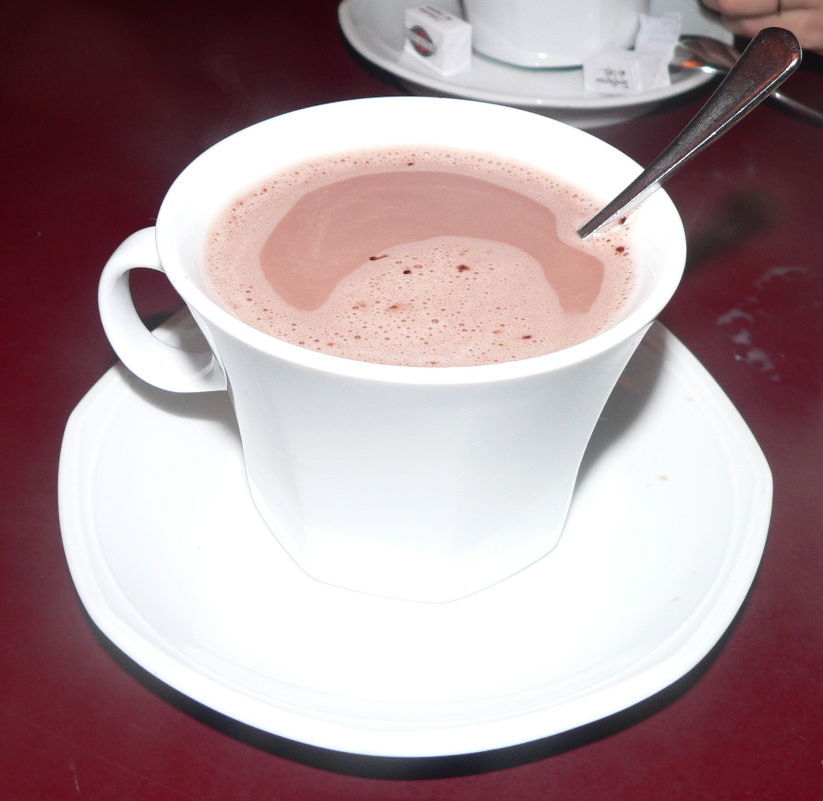
Making hot chocolate...in CODE!

Slide 15
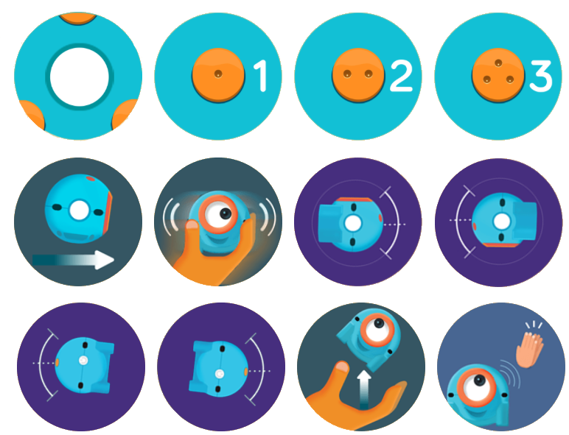
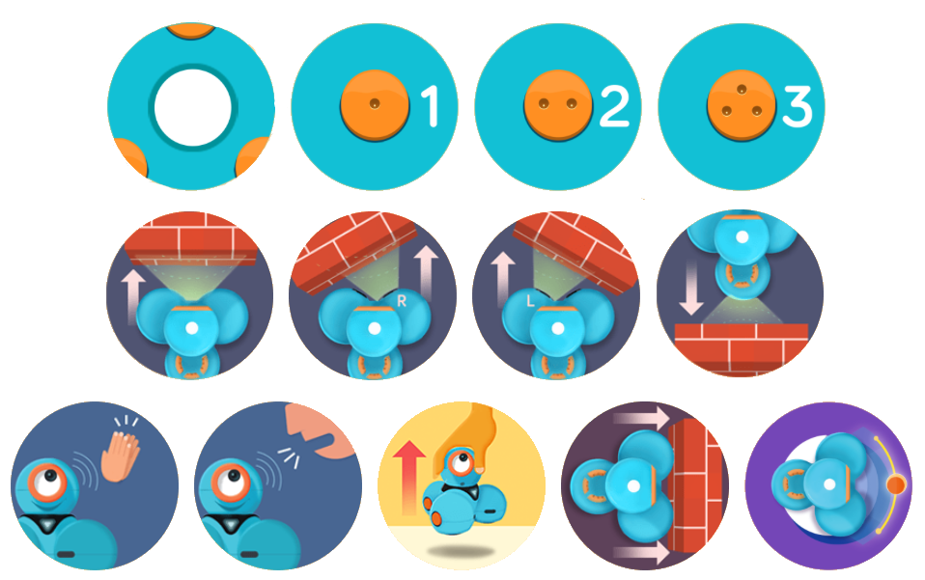
Dash
Events
Dot

Slide 16
Part 1
Apply
Notes:
https://www.youtube.com/watch?v=75-GMXoIzkE

Slide 17
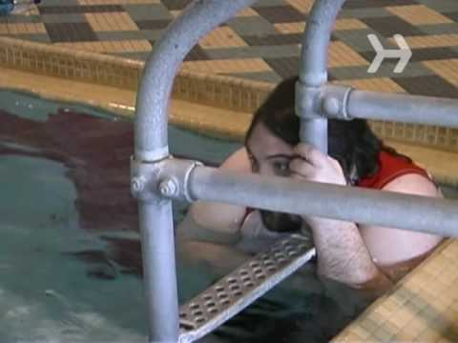
Learn to Play Marco Polo

